Slide 1
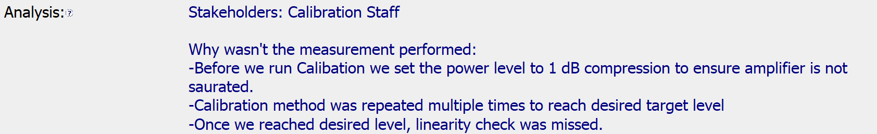
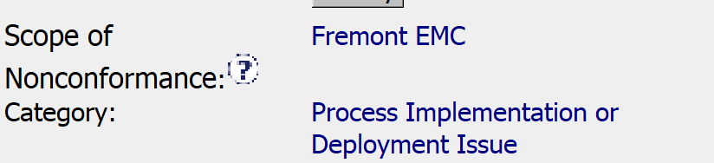
CAR 173917006 FINDING
1. Explain how/if the nonconformity is fully addressed in the analysis.
The analysis does not include the full list of stakeholders. The analysis does not clearly indicate why the linearity check “was missed” or why multiple calibrations would cause the linearity check to be missed.
2. Explain how/if the analysis supports the root cause statement.
The analysis indicates the root cause was multiple Cals being performed, but does not indicate why this would cause the missed linearity check.
Explain how/if the analysis supports the Scope of Nonconformance statement.
The site audited was Fremont and the scope indicates Fremont EMC lab. The analysis does not provide any clear information on the scope.

Slide 2
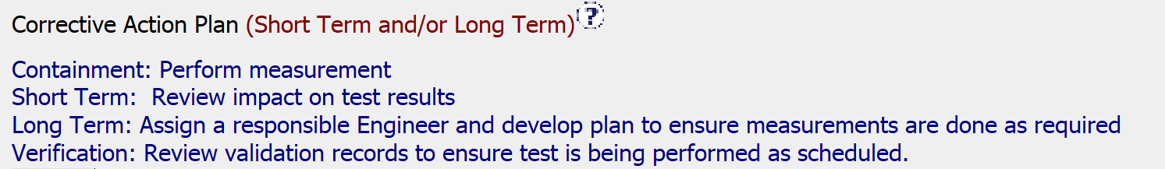
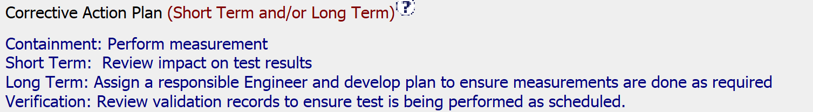
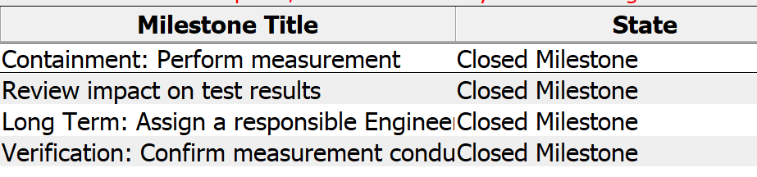
CAR 173917006 FINDING
4. Explain how/if CA Plan prevents recurrence of the nonconformity.
The CA included containment. Review of test results. Assignment of responsibility for the tests (EMC Manager), sign posted in test area and finally a review of records to verify effectiveness.
5. Explain how/if the containment milestone "stopped the bleeding“.
The containment milestone was to perform the linearity check and the records indicate passing results. This addressed the issue that was identified.
6. Explain how/if the CA milestones are aligned to each item of the CA plan.
Complete alignment.

Slide 3
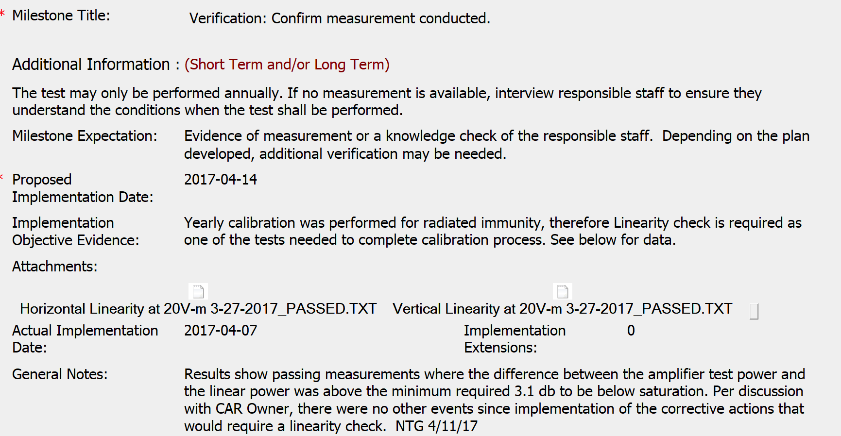
CAR 173917006 FINDING
7. Explain how/if the verification milestone confirmed the effective implementation of the CA plan.
The verification milestone included the results of the linearity check with passing results. This is performed as part of the yearly calibration. What could have been included is evidence of a knowledge check.

Slide 4
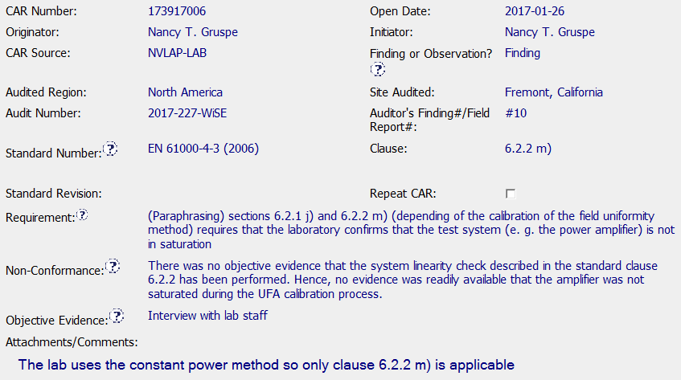
CAR 173917006 FINDING

Slide 5
CAR 173917006 FINDING
Explain how/if the nonconformity is fully addressed in the analysis. (Jeff)
It was partially supported. Since the Scope of this CAR included the entire Fremont EMC, other equipment and calibration requirements needed to be examined. Analysis was focused on one missed measurement and used the 5-Why approach resulting in “…linearity check was missed.” We still don’t know why it was missed nor the ripple effect this may have had with the entire Fremont EMC.
2. Explain how/if the analysis supports the root cause statement. (Tony)
It was partially supported. However, additional “why’s# are needed to explain, for example: (1) why they felt that the other calibration tests covered the "linearity check" test. (2) Not performing the “linerarity test” would it impact the results?

Slide 6

CAR 173917006 FINDING
Explain how/if the analysis supports the Scope of Nonconformance statement. (Tovia)
The analysis does not support the root cause statement, it is simply a restatement of the fact that the team did not do what was required
More analysis is needed
4. Explain why/if CA Plan will prevent the recurrence of the nonconformity. (Michelle)
Includes all the necessary steps, including:
Containment
Reviewing the impact (analysis)
Developing a plan (which might include training)
Verifying that the plan is effective

Slide 7
CAR 173917006 FINDING
5. Explain how/if the containment milestone "stopped the bleeding“. (Jeff)
It was partially supported. Containment was deemed appropriate by implementing the test requirement for saturation moving forward. The second milestone, which examined the impact of the missed tests, should have been included in containment in the event adverse effects needed to be addressed. One final note, this appeared to be focused on one test at the EMC rather than the larger Scope.
6. Confirm that/If all CA milestones are aligned to each item of the corrective action plan. (Tovia)
Line by line they correlate.

Slide 8
CAR 173917006 FINDING
7. Explain how/if the verification milestone confirmed the effective implementation of the CA plan. (Tovia)
No new events maybe adding milestones here would be appropriate. If no measurement is available, interview responsible staff to ensure they understand the conditions when the test shall be performed. No evidence of this.

